Slide 1
Supervised Learning Neural Networks
Daniele Marazzina
Politecnico di Milano

Slide 2
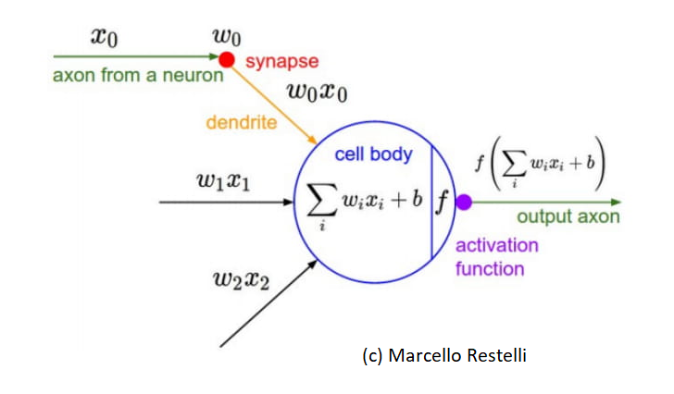
Method: Neural Network
(Artificial) Neural Network (ANN)

Slide 3
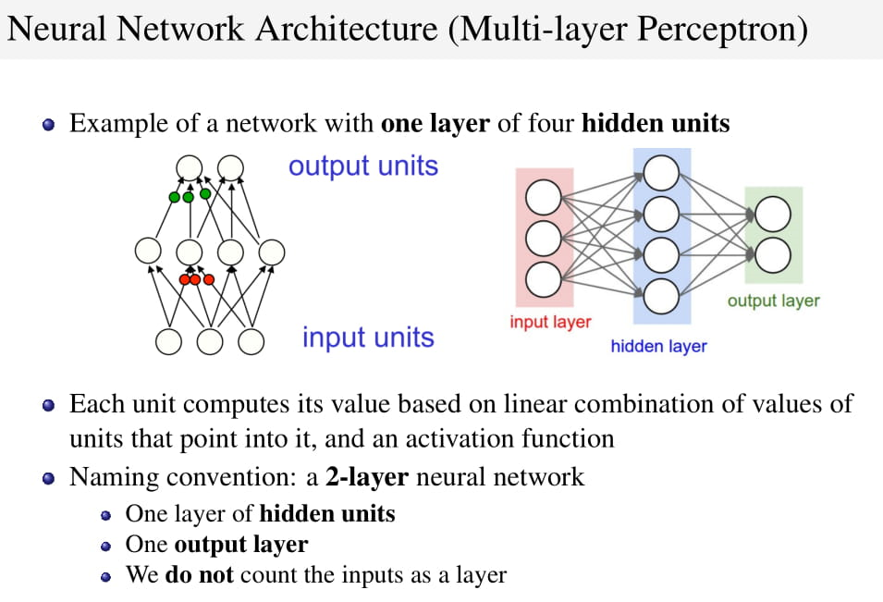

Slide 4
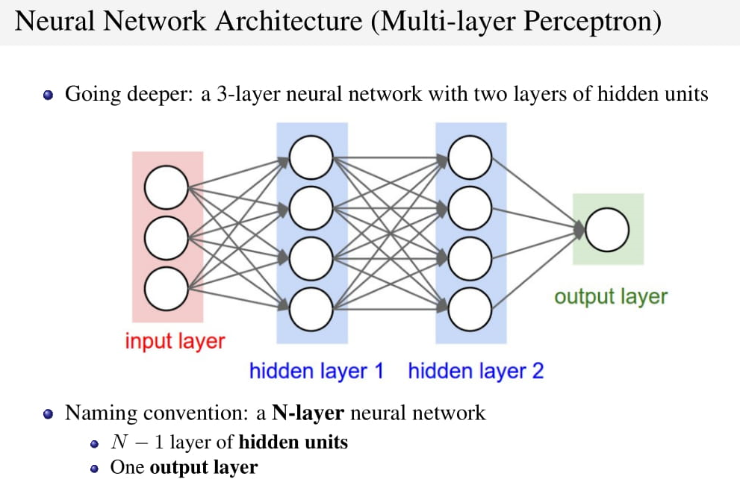

Slide 5
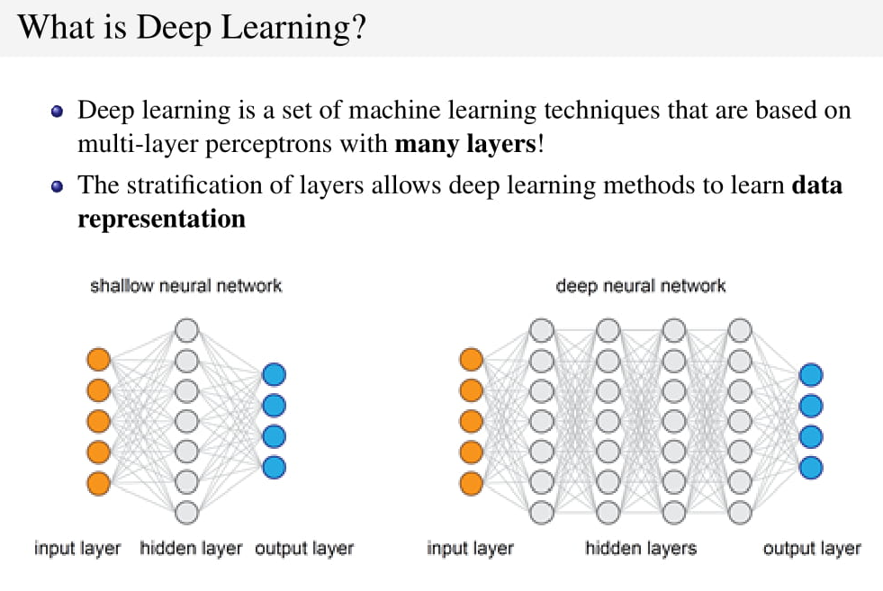

Slide 6
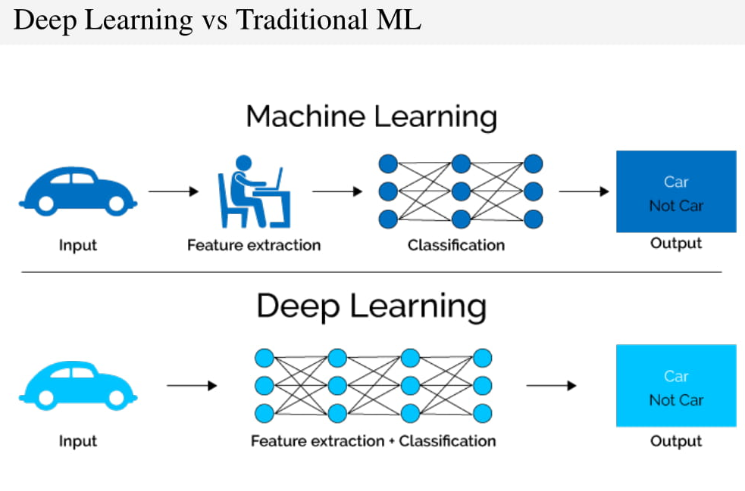

Slide 7
Activation

Slide 8
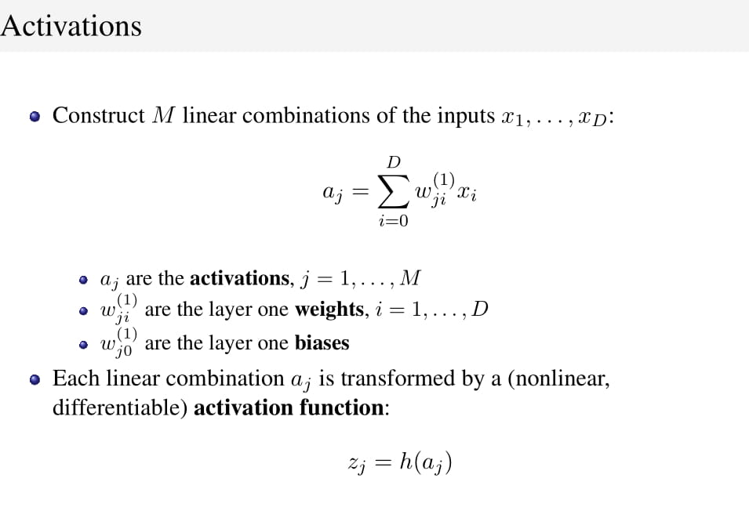

Slide 9
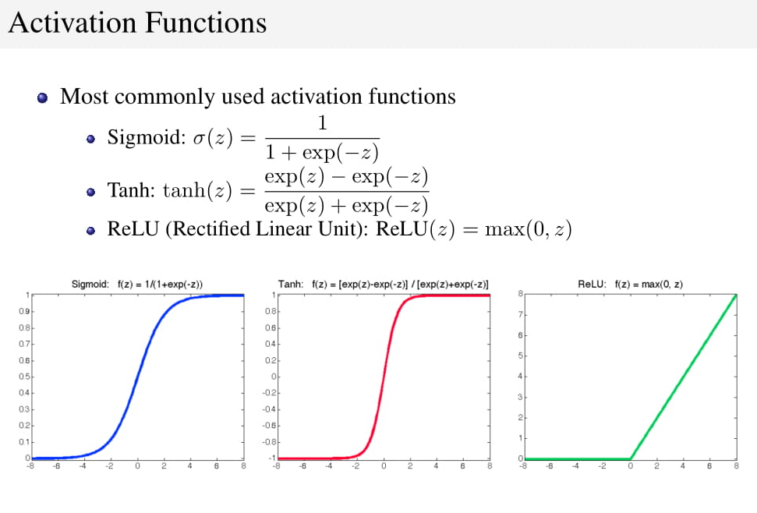

Slide 10
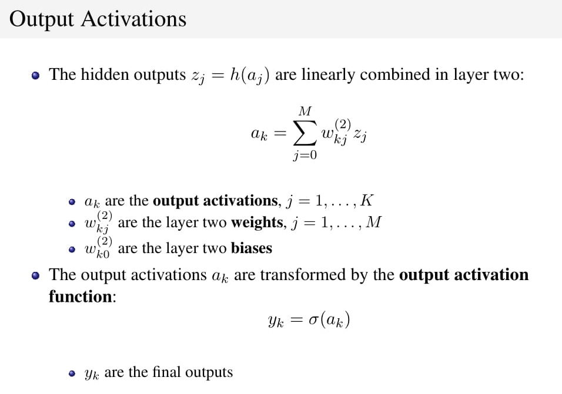

Slide 11
A simple network

Slide 12
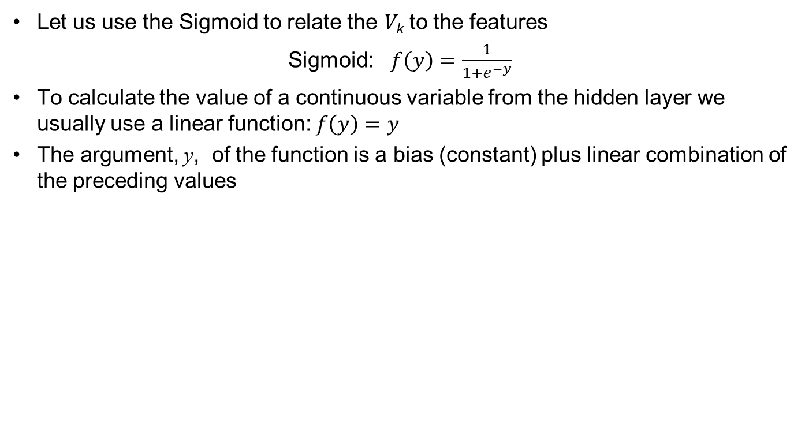
Activation Functions
Let us use the Sigmoid to relate the V_{k} to the features
Sigmoid: $f\left(y\right)=\frac{1}{1+e^{−y}}$
To calculate the value of a continuous variable from the hidden layer we usually use a linear function: $f\left(y\right)=y$
The argument, y, of the function is a bias (constant) plus linear combination of the preceding values

Slide 13
A second simple network
This works in the same way as the previous network except that the sigmoid function is also used to relate Q to the V “s

Slide 14
Universal Approximation Theorem
Any continuous function can be approximated to arbitrary accuracy with one hidden layer (See K. Hornik: Neural Networks, 1991, 4:251-257)
But this may require a very large number of neurons.
Using several hidden layers can be computationally more efficient

Slide 15
Number of Parameters
Neural networks can have a very large number of parameters
If there are F features, H hidden layers, M neurons in each hidden layer and T targets the number of parameters is
(F+1)M+M(M+1)(H-1)+(M+1)T
The first (house price) neural network has 13 parameters and the second (credit) neural network has 19 parameters
But in practice a small neural network might have 4 features, 3 hidden layers, 80 neurons per layer and one target for a total of 13,441 parameters.
Larger neural networks have hundreds of thousands of parameters

Slide 16
How to deal with such a large number of parameters?
To minimize an objective function such as mse, a gradient descent algorithm calculates the direction of steepest descent, takes a step, calculate a new direction of steepest descent, takes another step, and so on
The partial derivatives with respect to the parameters are calculated by a procedure known as backpropagation.
The size of the step is the learning rate. If the step is too small the algorithm will be very slow. If it is too large there are liable to be oscillations

Slide 17
Other Details
Use mini batches of data to calculate gradients. (One epoch is one complete use of training set) → stochastic gradient descent
Adaptively calculate the learning rate (Adam)
Learning rate decay
Stopping Rule
Because applications have many parameters it is important to use a stopping rule to avoid over-fitting
We calculate results for the validation set at the same time as the training set.
When the results for the validation set start to get worse we stop

Slide 18
Convolutional Neural Network (CNN)
In a vanilla ANN the layers are fully connected which can give rise to a very large number of parameters
In a convolutional neural network, the number of neurons in one layer that affect the next layer is reduced.
Used for image recognition where each pixel can be a feature
Consistent with the way neurons in the eye work

Slide 19
A “receptive field” in input layer determines value at a neuron in “feature map” of first hidden layer

Slide 20
CNN: Key Advantages
Consider a image that is 100×100 or 10,000 pixels
A regular neural network would lead to 10,000×(10,000+1) or about 100 million parameters to define the first layer.
If a CNN’s receptive field is 10×10 and a layer has 6 feature maps only 6×101=606 are required
More importantly, once the CNN has learned to recognize a pattern in one location it can recognize it in another location.

Slide 21
Recurrent Neural Network (RNN)
In a vanilla ANN, the v’s are functions of the inputs and the sequence of the inputs does not matter
In a recurrent neural network there is a time dimension to the data. The current v’s are made functions of the corresponding previous v’s (or possibly previous outputs) as well as current inputs
A long short-term memory (LSTM) network is a type of RNN where part of the algorithm learns what should be remembered and what should be forgotten from previous data

Slide 22
RNN: Applications
Sequential data where the relationship between targets and features may be changing through time
Particularly relevant for finance where we are often dealing with time series data
Also use in natural language processing (e.g. autocomplete tool)

Slide 23
A first code
convolutional neural network
Matlab & Neural network
For classification
For image recognition
For forecast
Long short-term memory (LSTM) an artificial recurrent neural network architecture

Slide 24
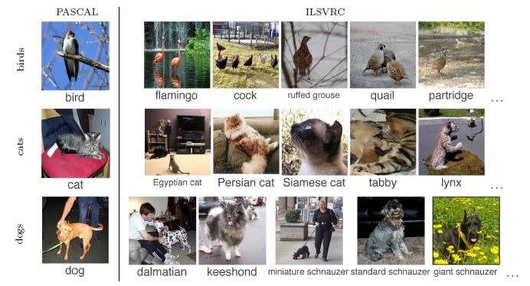
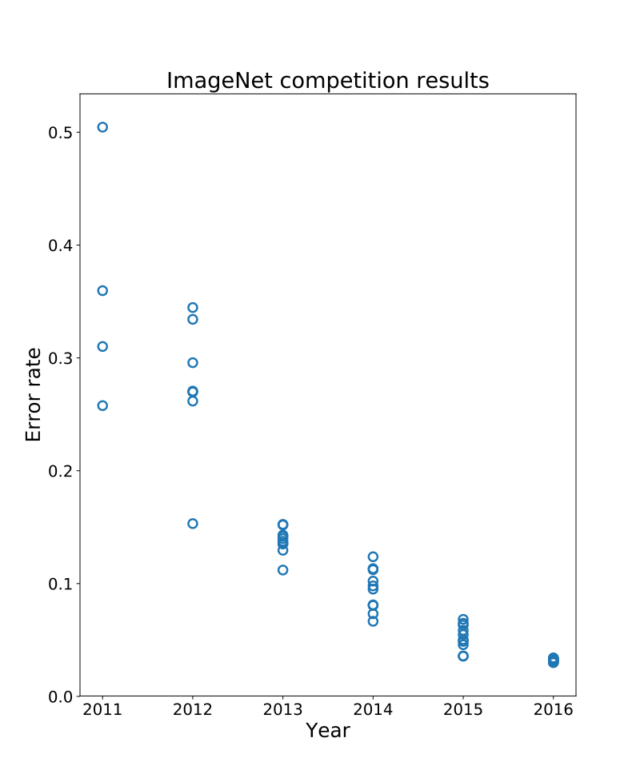

image recognition
AlexNet

Slide 25
A second code
Interpolation of data
File Supervised.ipynb
Minimizer: Adam Algorithm

Slide 26
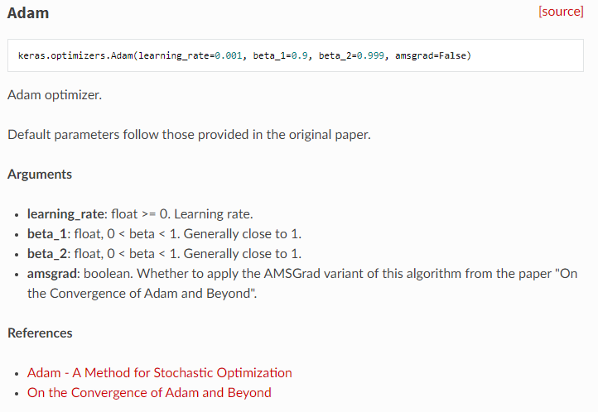
>> Adam algorithm

Slide 27
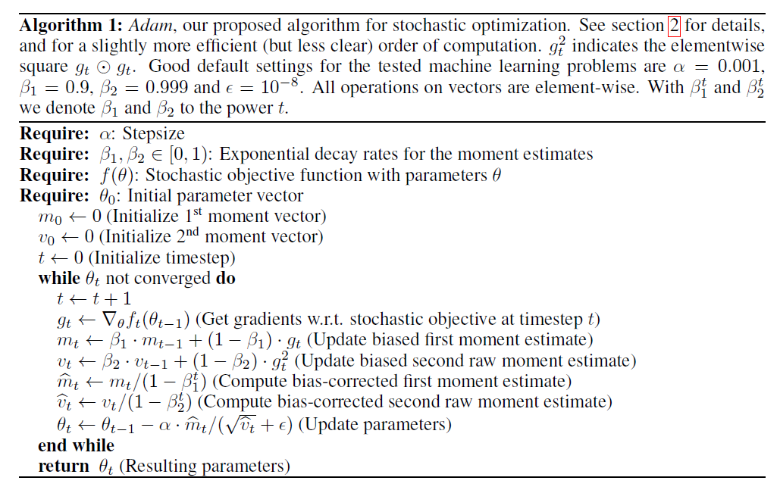
Alpha is the learning rate

Slide 28
Black-Scholes-Merton Application
We generated 10,000 call option prices using the Black-Scholes-Merton model and then added a normally distributed error of 0.15 to the price.
The parameters were sampled randomly from uniform distributions
The model had three hidden layers and 20 neurons per layer
File: BlackScholesReplication.ipynb

Slide 29
Training set and validation set mse as the epochs of training is increased

Slide 30
Smoothed mse (Moving Average over 50 epochs)

Slide 31
Results
With only 10,000 observations the neural network imitated the Black-Scholes-Merton model well
It eliminated much of the random noise we added to the BSM prices.
Calibration
Now: let us calibrate the B&S model via Neural Network
File: BlackScholesCalibration.ipynb

Slide 32
Application to Derivatives
Some instruments are valued using Monte Carlo simulation
But banks often have to use Monte Carlo simulation for scenario analysis and to calculate the VAs (Valuation adjustments)
There is then a “Monte Carlo within Monte Carlo” problem.
To solve the problem you can do an initial analysis to generate a large amount of data relating prices to input variables
Use a neural network to get a good fast approximation for a pricing model

